Slide 1
Software Product Management Ongoing product management
Nandagopal Govindan

Slide 2
Contents
Customer support
Product improvement & enhancements
Situations triggering product change
Continuous product innovations (value enhancement)
Software Product Lines

Slide 3
Introduction
A new set of activities begin after product release
Some examples:
Resolving customer issues
Improving the product – UX, performance, bug fixes, security fix
Keep adding value with relevant features – whole product
Adapt to changes in user needs, technology, competition
Leverage the product – Open source, product line, cater to new segments

Slide 4
Customer support
Quick and effective customer service is paramount. How?
Make the product so simple to use and so high in quality that support is a non-issue
Support team should be sufficiently staffed & knowledgeable
Recruit people who have a high degree of empathy who feel the pain of the customer
Empower staff to take decisions, example to give refunds where genuine
Examples of excellence in customer support
IBM delivery a small part flying its engineer to customer site,
Buffer Inc. provides superior customer support which helps market itself
Do you have any examples of great customer service?

Slide 5
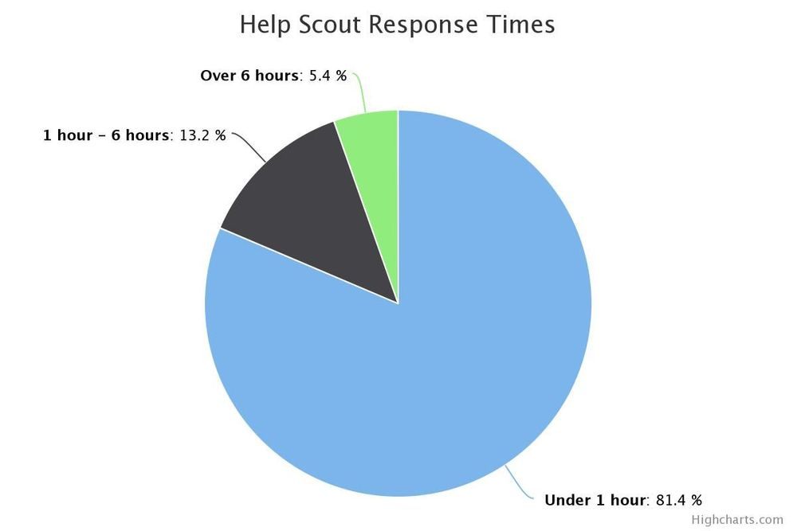
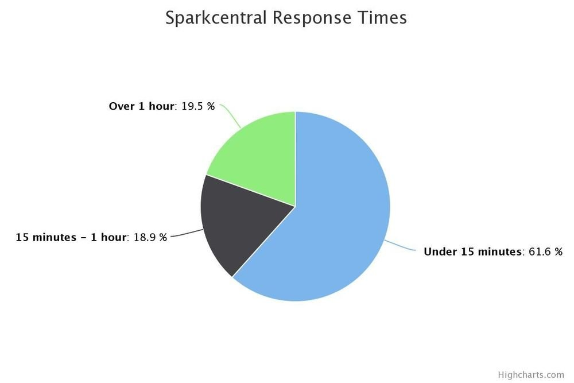
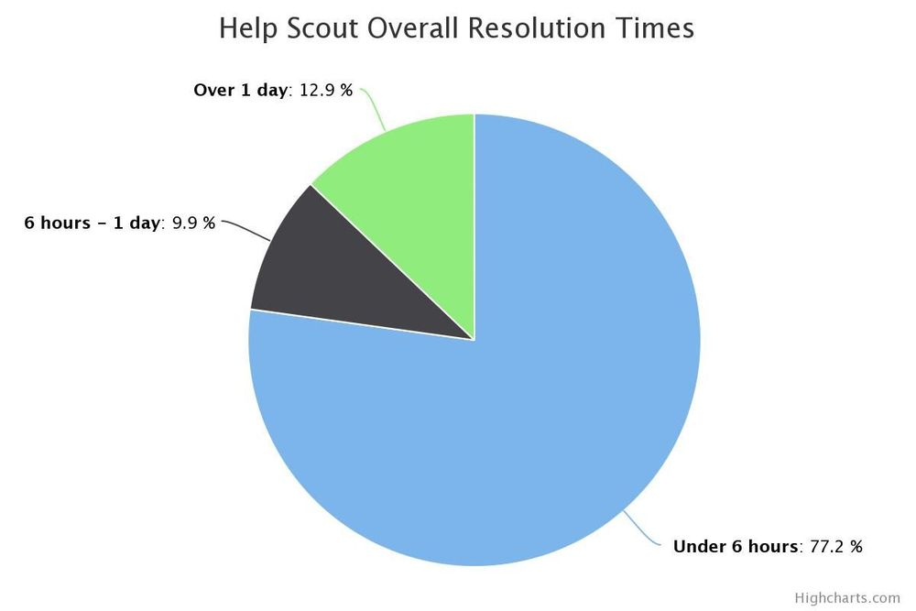
Measuring customer service at Buffer Inc.
Email responses
Twitter responses
Resolution time
https://buffer.com/resources/june-happiness-report-self-select-urgency/

Slide 6

Support channels
Several support channels can be used:
Email, Twitter, Facebook, Phone, Remote desktop, FAQ, Ticketing system, Bot
What channels of support exist in your organization?
High touch vs low touch:
High touch service involves human interaction as against automated systems (IVR), FAQ, etc.
Mission critical products such as SAP, Navitaire, Shopify, etc. need high touch support
Choose the right channel
Wistia: How did it optimize support?
StudioPress: How did it provide support?

Slide 7
Service Quality
Ensure quality of service using concepts of SERVQUAL

Slide 8
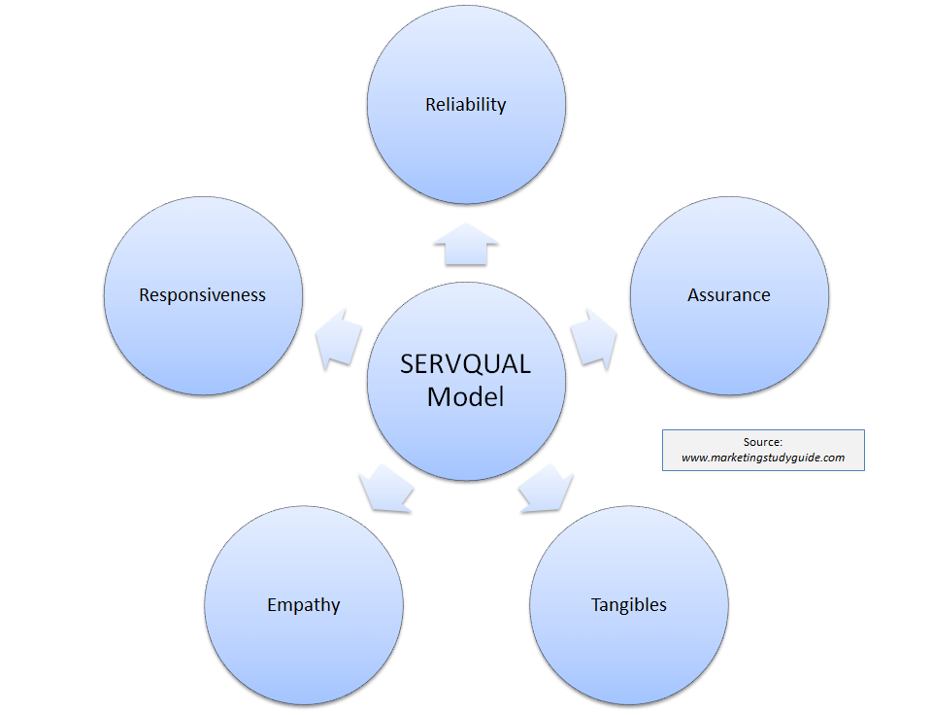
What are the characteristics of a service quality (SERVQUAL)?
Which service quality characteristic is most important in your project?

Slide 9
Service Quality
Reliability is the firm’s ability to perform the promised service accurately and dependably
Responsiveness is the firm’s willingness to help customer and provide prompt service
Assurance is knowledge and courtesy of employees and their ability to inspire trust and confidence
Empathy is caring and individualized attention paid to customers
Tangibles refers to physical facilities, equipment and appearance of personnel

Slide 10
Exercise: SERVQUAL
Which service quality are we referring to in the scenario described below:
The hotel room has pleasing colours
Tangibles
When a problem is fixed, another appears
Reliability
When the network fails, it is fixed in 1 hour
Responsiveness
The engineer is able to clear all doubts of customer satisfactorily
Assurance
The engineer understands the urgency and goes the extra mile to help
Empathy

Slide 11

Product improvements & enhancements
Improve the product based on customer feedback
Example
Slack: Integrations with email, channels / group chats
Postman: Documenting APIs, Mocking APIs for front end development)
Any other?
Case study in product improvement: How to listen to customers and analyse them before implementing: Interview with Jim Lynch, Salesforce. What can we learn from this case study?

Slide 12
Experience sharing…
How are customer suggestions analyzed and acted upon in your organization?

Slide 13
Release planning
Minor releases to fix critical issues
Major releases containing new features & enhancements
Feature prioritization can be based on
Value to customers
Need to match competition
Cost of development and support
Technical complexity and dependencies
Urgency of refactoring
How does release planning happen in your company?

Slide 14
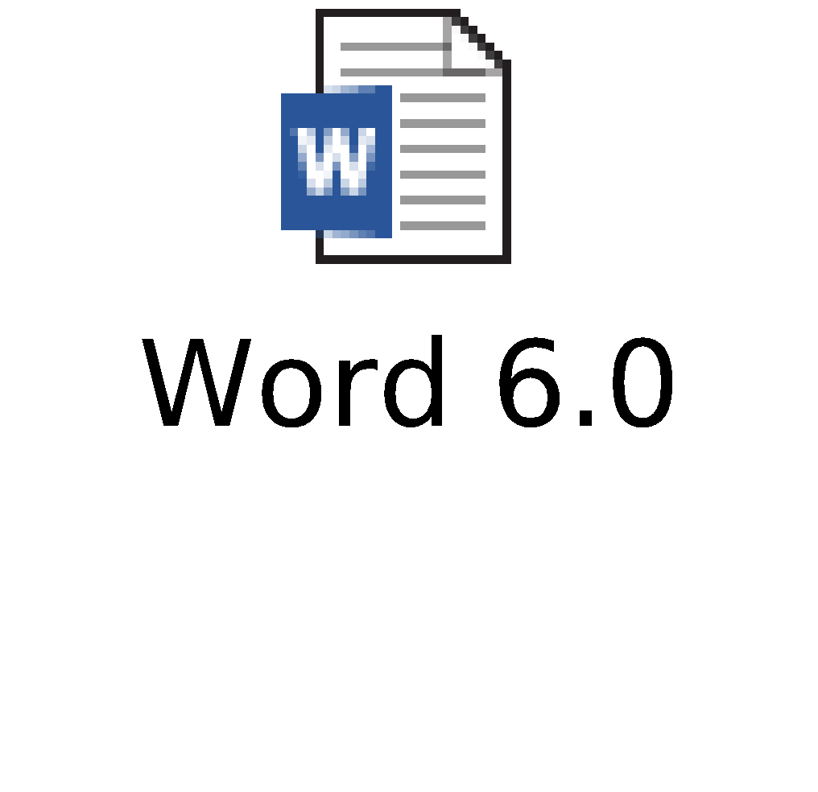
Case study of product improvement: Word 6.0
Word 6.0 on Apple Mac OS
Questions:
Why did Microsoft want to converge Word on Windows with that on Mac?
Why did they drop this idea?

Slide 15

Situations triggering Product change
Changing user needs
Amazon Pay-on-delivery
Ola SOS button
Changing regulations – SOX, GST
Changing standards – Word introduced ‘Save as PDF’
Changing technology
Amazon moved from monolithic architecture to Micro-services
Any other type of change?
Case study: Adobe Creative Cloud - Desktop to Cloud
What were the challenges?
How were they overcome?

Slide 16
Experience sharing…
What challenges did you face in making major changes to your product?

Slide 17
Continuous product innovations
We need to continuously add value to clients
Examples:
Netflix: Online order for DVD rental, recommendations feature to make it easy to choose, video streaming, own productions
AirBnB Covid pivot: Virtual experiences – Jungle safari, magic shows, Rio street art
BigBasket: Vending machine in apartment complex, Booking delivery slot
Women safety in Ola
Amazon: eCom, Prime, AWS, Alexa, Amazon Go, …
eBay: ‘Buy now, Pay later’, Buyer seller negotiations, Auto search every day for a product you are looking for
Paytm – Video KYC
Other examples of continuous innovation?

Slide 18
Software Product Lines
Examples
Telelink inter-office email: supports UUCP, LAN, Netware, RABMN (1990s)
Rockwell Collins: Helicopter cockpit system caters to multiple types of helicopters
SAP: Caters to Manufacturing, Insurance, Telecom, Retail
Any other?
Product lines share a common set of features
Achieves order-of-magnitude improvements in time to market, cost, productivity & quality

Slide 19
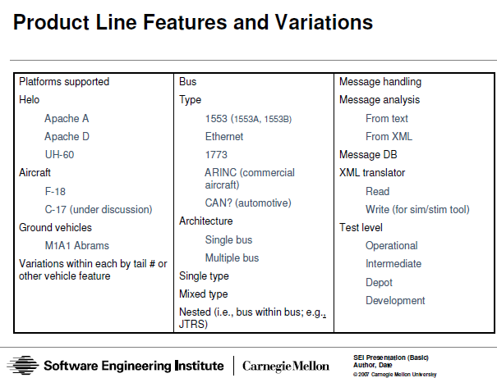
Case study: Saturn Aviation Diagnostics and Maintenance
https://resources.sei.cmu.edu/library/asset-view.cfm?assetid=21312

Slide 20
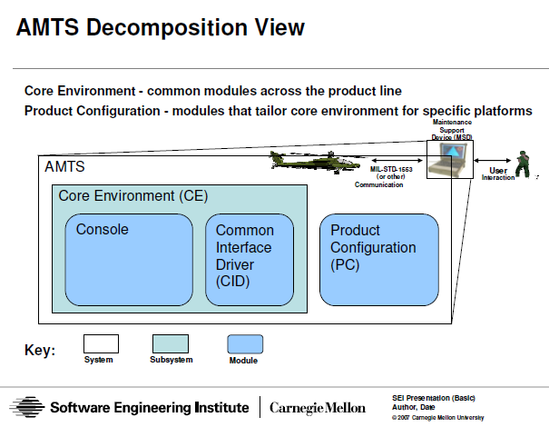
Case study: Saturn Aviation Diagnostics and Maintenance

Slide 21
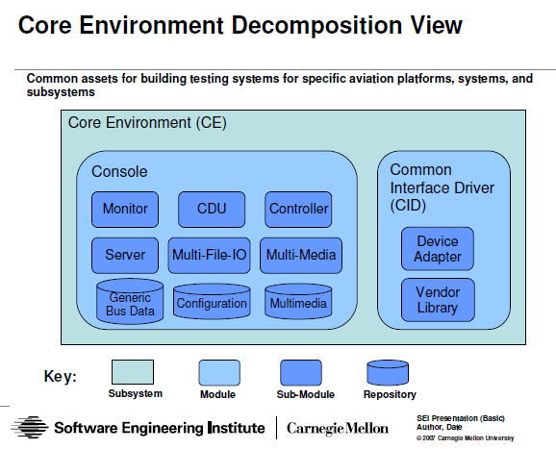
Case study: Saturn Aviation Diagnostics and Maintenance

Slide 22
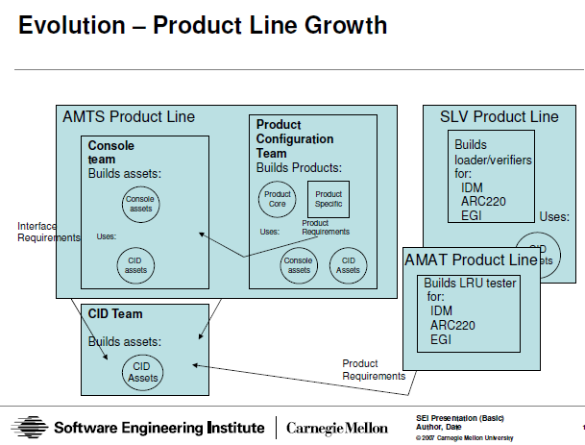
Case study: Saturn Aviation Diagnostics and Maintenance

Slide 23
Lessons in Product lines
Architecture is the foundation
Need to identify common elements
Need to have an organization structure to maintain common elements and build specific products

Slide 24
Experience sharing…
What challenges did you face in developing products using product line concept?

Slide 25
Appendix

